Slide 1
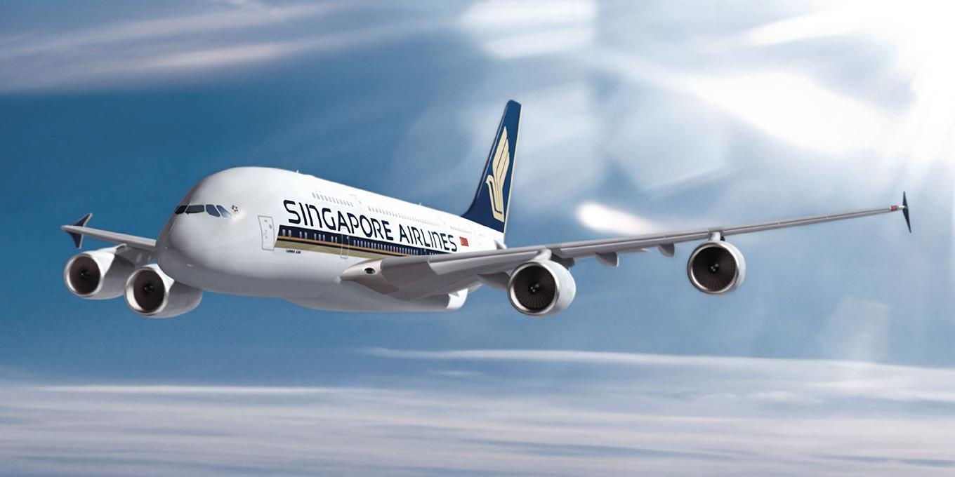
SIA APP CHALLENGE 2016 MYJOURNEY

Slide 2
… … dedicated to providing air transportation services of the highest quality … …

Slide 3
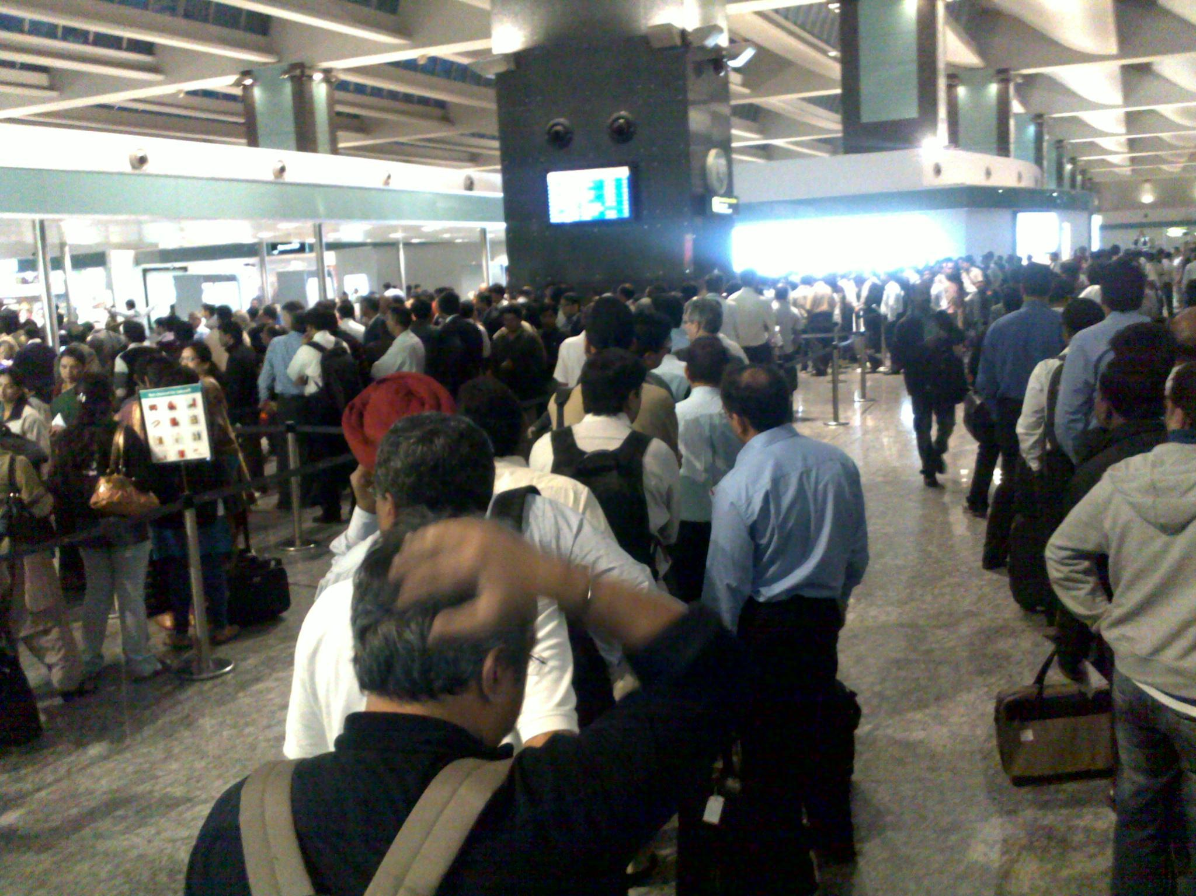

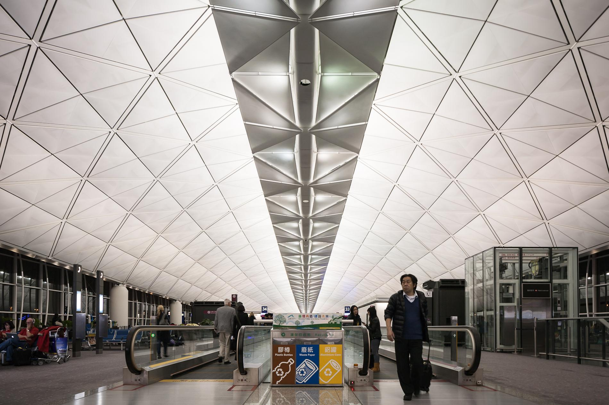
Common Challenges Passengers Face
Seamless
Travel
Experience
Difficult to navigate around airports
Travel inefficiencies and hiccups due to lack of real-time flight information
Existing travel information is difficult to consolidate

Slide 4
1. Introduction to MyJourney

Slide 5
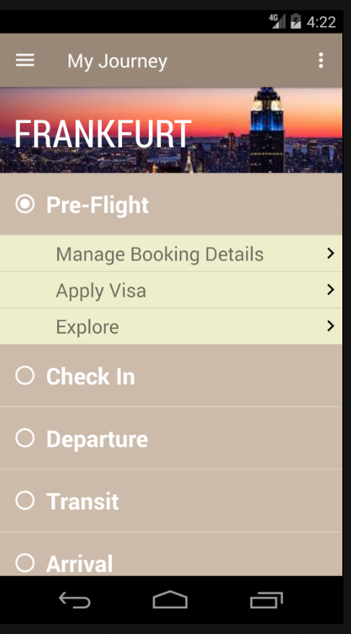
MyJourney
Breaks down entire journey into stages for ease of planning and reference
Consolidates all administrative tasks and information required at each stage
Minimizes risk of negative travel surprises
Insert screenshot of main page. Either show all the headers only to demonstrate the different stages or show all of them open???

Slide 6
DEMONSTRATION

Slide 7
Providing a Seamless Travel Experience
Losing track of time and missing a flight
Getting lost at the airport at arrival
Forgetting to apply for a visa
Booking tickets
Check-in
Boarding
On board
Arrival

Slide 8
2. Business potential

Slide 9
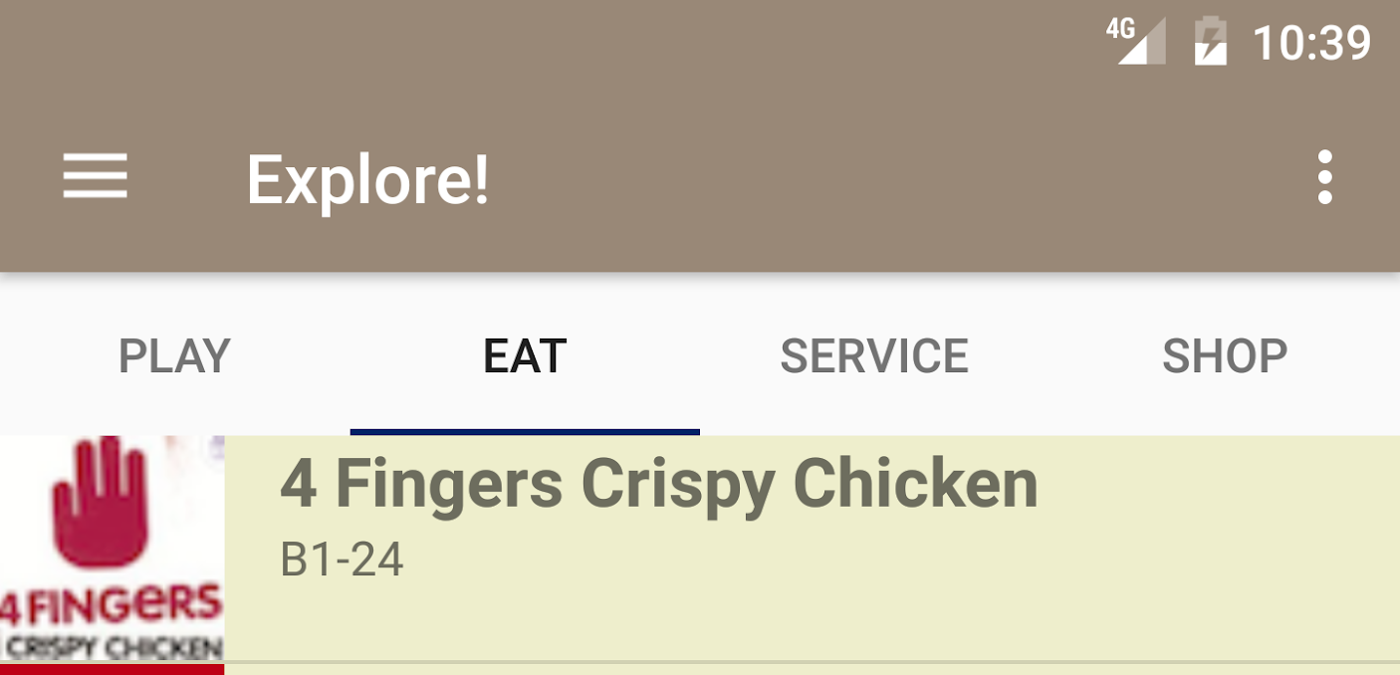

CONTEXT-BASED ADVERTISING
Earn ad commissions from retail outlets, service providers, etc on the Explore page
4Fingers Promotion:
Display your SIA boarding pass to receive 15% off all meals!
CART
PAY

Slide 10
iBEACON
Automatically tracks users’ stage and location

Slide 11
Global reach
19,029,000
6 continents
35 countries
63 international
destinations

Slide 12
THANK YOU

Slide 13
SlidesCarnival icons are editable shapes.
This means that you can:
Resize them without losing quality.
Change line color, width and style.
Isn’t that nice? :)
Examples:

Slide 14
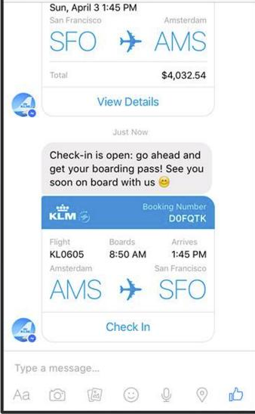
REMOTE DISSEMINATION OF INFORMATION

Slide 15
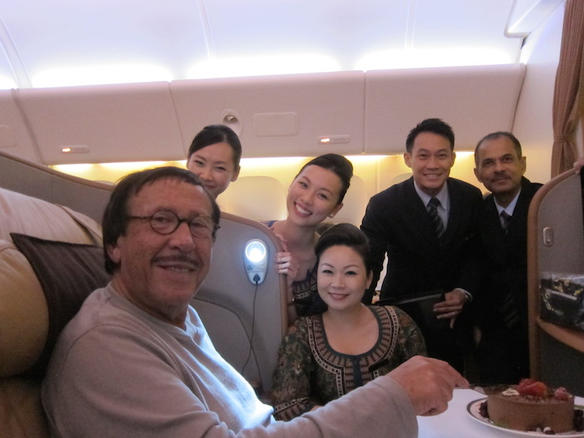
“THE LENGTHS WE GO TO”
Minimize passenger flight errors
Provide new service experiences
Ease of navigation.

